Slide 1
NTTC Virtual Training Health Savings Accounts Part 4 Distributions
Core
Publish date: September 22, 2020

Slide 2
Health Savings Account (HSA) Video Series
Part 1 HSA Contributions – Core
Full year eligibility
Part 2 HSA Contributions – Comprehensive
Partial year eligibility
Part 3 Rules for Married Taxpayers – Comprehensive
Part 4 HSA Distributions – Core

Slide 3
HSA Distributions
An HSA is a type of savings account that allows taxpayers to set aside pre-taxed money to pay for qualified medical expenses
Distributions not taxed if offset by qualified medical expenses
Expense must be incurred after HSA established
Even if the last-month rule is used (See HSA Video Part 2)
No time limit to take distribution and offset with current year or prior year medical expenses (must be after HSA established)
Do not deduct medical expense on Schedule A if expenses will be reimbursed by HSA
Notes:
Funds can stay in HSA for year

Slide 4
Knowledge Check
True or False?
Anna’s HSA was started in 2017
Anna incurred $602 in qualified medical expenses in 2018 and she did not deduct these expenses on Schedule A
Anna’s 2019 $602 HSA distribution to cover the 2018 qualified medical expenses is not taxable

Slide 5
Knowledge Check
True
Anna’s HSA was started in 2017
Anna incurred $602 in qualified medical expenses in 2018 and she did not deduct these expenses on Schedule A
Anna’s 2019 $602 HSA distribution to cover the 2018 qualified medical expenses is not taxable

Slide 6
Qualified Medical Expenses for HSA
Qualified medical expenses include
Medical and dental expenses that would qualify as itemized deduction
See chart in Pub 4012 or Pub 502
New for 2020
CARES Act permanently restores ability to use HSA distributions for certain over the counter products and medications without prescription purchased after December 31, 2019
Includes menstrual products

Slide 7
Knowledge Check
Which of the following are considered HSA qualified medical expenses?
Medical marijuana with prescription
Over the counter cold medication
Cosmetic surgery
Insulin without a prescription

Slide 8
Knowledge Check
Which of the following are considered HSA qualified medical expenses?
Medical marijuana with prescription
Over the counter cold medication
Cosmetic surgery
Insulin without a prescription

Slide 9
Qualified Medical Insurance Expense
Insurance premiums that are qualified medical expenses for HSA distribution purposes
Long-term care coverage
COBRA
Coverage while receiving unemployment
Medicare or other coverage if 65 or older
Not supplemental coverage, e.g. medi-gap
Notes:
See Publication 502, Medical and Dental Expenses, for more information

Slide 10
Qualifying Expense for Family members
Qualifying expenses incurred by
Taxpayer and spouse
Dependents claimed on return
Others who could have been claimed as a dependent except that
Person filed a joint return – or –
Person failed gross income test ($4,300 for 2020) – or –
Taxpayer or spouse could be claimed as a dependent on another’s return
Even if it’s a self-only high deductible health plan (HDHP)
Notes:
TIP: A child of parents who are divorced, separated, or living apart for the last six months of the calendar year is treated as the dependent of both parents (for medical expenses) whether or not the custodial parent releases the claim to the child’s exemption.
TIP: Even taxpayers who have a self-only HDHP may use the money in their HSA to pay the unreimbursed medical expenses for their spouse or other family members (as described previously).

Slide 11
Knowledge Check
Juan has an HSA and a self-only HDHP. Juan can use his HSA to pay qualified medical expenses for which of the following individuals?
Juan’s spouse
Juan’s cousin (could not be his dependent)
Juan’s dependent children
Juan has a self-only HDHP so only Juan’s medical expenses qualify

Slide 12
Knowledge Check
Juan has an HSA and a self-only HDHP. Juan can use his HSA to pay qualified medical expenses for which of the following individuals?
Juan’s spouse
Juan’s cousin (could not be his dependent)
Juan’s dependent children
Juan has a self-only HDDP so only Juan’s medical expenses qualify

Slide 13
HSA Distribution TaxSlayer Entry 2019
Juan is 36 and married
Juan has 2 children with the following medical expenses in 2019
Doctor co-pays: $2,500
Prescriptions: $1,006
Juan withdrew $3,506 from his HSA to pay medical expenses

Slide 14
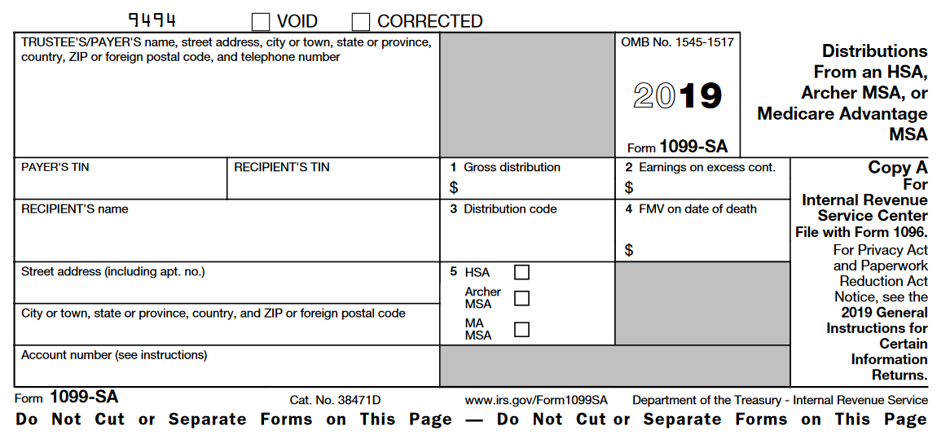
Form 1099-SA Distributions
Acme Inc
974 Lincoln Ave
Austin, TX 78737
12-3456789 321-00-4321
$3,506
Juan HSA IV Distributions
123 Main St
Austin, TX 78737
1
√

Slide 15
Non-Qualified Distribution Example
Juan withdrew $3506 from his HSA however he only incurred $3,000 in qualified medical expenses in 2019
$506 will be included as other income on Schedule 1
Juan will pay an additional 20% tax on the $506 non-qualified distribution

Slide 16
Return Mistaken Distribution
If mistaken distribution due to reasonable cause, Juan can repay the $506 to his HSA*
Must be returned to HSA by April 15th
This is a hard date, not the due date of return
$506 will not be included in income
Not subject to additional 20% penalty
*If allowed by the HSA trustee or custodian

Slide 17
HSA Distribution Resources
There are significant aspects of tax law that have NOT been covered. You need to be aware before you prepare a return. Find complete information in the resources below.
Pub 4012
Pub 4491
Pubs 969 and 502
Form 8889 and Form 1099-SA Instructions
Link & Learn Taxes Health Savings Accounts (HSA)
NTTC Slide deck 44 Health Savings Account
NTTC HSA videos: AARP portal > search “Online Training Guide”

